Slide 1
Image Colorization Using CNN

Slide 2
Agenda
Motivation and Objective
Data Preparation and Cleaning
Model Building
Training
Web app
Demo
Conclusions
Limitations
Q/A

Slide 3
Motivation
To understand how the NN handles image data
Understand CNN
Train CNN from scratch

Slide 4
Objective
Given a grayscale image, produce the same image with added color.
Train CNN
Build a gradio web app as a final outcome.

Slide 5
Data Preparation and Cleaning
Data source:
Kaggle: https://shorturl.at/s9yn3
It contains 5000 train images and 739 test images
Each image has size 400x400
Data preparation steps:
Remove false color images. There were 157 false color images.
Resize to 256 x 256
Convert RGB to LAB

Slide 6
Model Building
Architecture
Unet like custom neural network build in Pytorch
Main layers: Conv2d, BatchNorm2d, ConvTranspose2d, Relu
Kernel size: 4 x 4
Params: 364,3514
Input shape:
256 x 256 single channel image
Output shape:
256 x 256 dual(AB) channels

Slide 7
Model Training
- Optimizer : Adam
Loss Function: MSE
Hyperparameters:
Learning rate: 1e-3
Batch Size : 96
Kernel Size : 4 x 4
Epochs : 300
Weight decay : 0.001
Train time: 5:37 hrs (Nvidia T4 - 2x)
Data Split:
Train: 80%
Val : 20%
Test : hold out set
Results:
Train MSE: 50
Val MSE : 200
Test MSE : 215

Slide 8
Web App
Built using Gradio framework.
Steps:
Takes b/w image
Resize into 256x256 size
Convert into LAB format.
Make prediction
Build RGB image and rescale back to original size

Slide 9
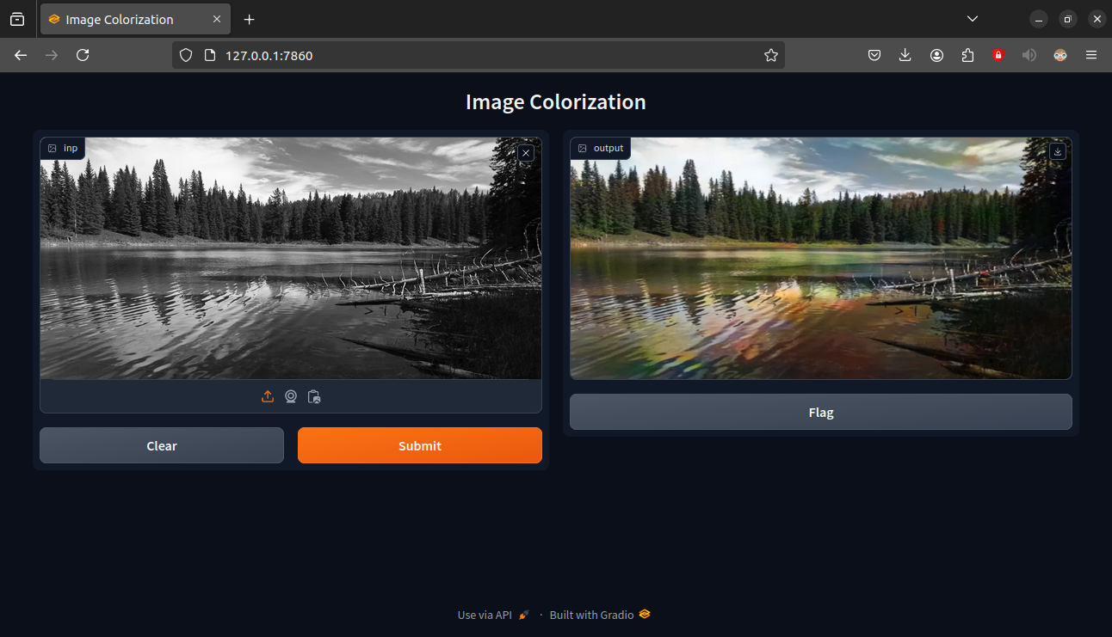
Screenshots

Slide 10
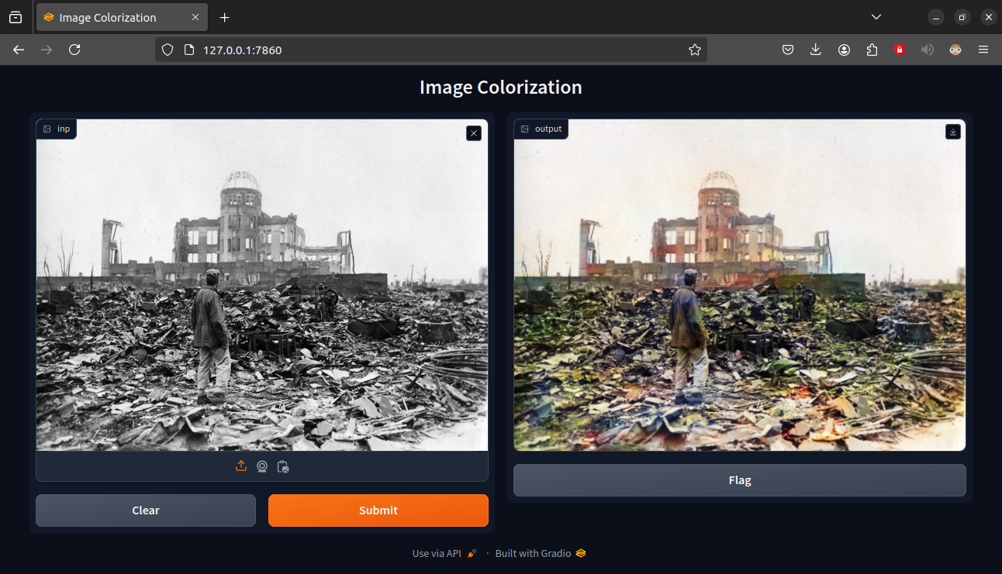
Screenshots

Slide 11
DEMO
Lets see the demo.

Slide 12
Conclusion
Trained U-net like architecture
Built functional web app for colorization
Lessons Learned:
Data quality is important than NN
SGD optimizer vs ADAM
How CNN works

Slide 13
Limitations
Despite regularization, model still has variance.
Model works best for square images than landscapes or vertical images, since model is trained on 256 x 256 square images.

Slide 14
Reference
Dataset : https://shorturl.at/s9yn3
CNN Blog post: https://shorturl.at/JuBM2
Colorization techniques: https://algoritmaonline.com/image-colorization/

Slide 15
Q & A

Slide 16
Thank You

